Slide 1

Talakag Water Billing System
ISC 34
Baclayo, Baconga, Casinillo, Faciolan, Fuentes, Lamique, Gallardo, Nocete, Olinan, Pelayo, Prejan, Quidong, Santos, Sara, Sherry

Slide 2
Problem Identification
The Talakag Municipal Water System is the only water provider in the Municipality of Talakag, supplying over 1500 consumers.
They are responsible in facilitating the transactions and records of every water concessionaire in the Municipality of Talakag.
They provide and encode the water meter readings of their consumers and send billings and notices every month.

Slide 3
Problem Identification
It has been a challenge for the Talakag Municipal Water System to monitor the records of their consumers without a proper profiling system.
They simply encode the records and transactions of over 1500 consumers with the use of Microsoft Excel, which takes a lot of work and time to do.
Also, they need to manually calculate every water meter reading, summing up previous water meter readings with the present readings. Without a proper profiling system, delays and discrepancies occur.

Slide 4
Problem Identification
They should be able to distribute billings every month, however it will somehow reach more than that to do so.
All payments are being done in the Office of the Treasurer of Talakag, so when it comes to disconnection, they sometimes forget to disconnect an unpaid consumer, supposedly the disconnection should be in 2 months, but without realizing, it will reach up to 5 months or to a year at the most. Moreover, some paid consumers are mistakenly disconnected from their supply.

Slide 5
Requirements Determination
The system is exclusively made for the Talakag Municipal Water System’s use. It will contain consumer profiles, showing their basic information, filtered by residential or commercial consumers. It will include each consumer’s transaction history; consumption (water meter readings) and payments.

Slide 6
Requirements Determination
This system was proposed to have a fast and precise profiling and transaction recording system for the Talakag Municipal Water System. This will allow them to properly monitor each consumer’s transaction status, to provide billings on time and disconnections when necessary. The system can also provide information as a basis of development and innovation of their current water meter reading calculation and water supply.

Slide 7
Requirements Determination
The system will have the following functions:
It must require a user to login first before the system can be used, a valid username and password will be required.
It must show the consumer's (residential or commercial) basic information such as name, address, contact number, birthdate and date of connection with payment history such as due dates, balances and payments.

Slide 8
Requirements Determination
It must allow the user to add, remove and update information in the consumers profile and transaction history.
It should be able to calculate the water meter readings which are indicated in cubic meter and display the total amount to be paid.
It must allow an overview of the number of consumers who have paid and not paid their bills and the total number of consumers.

Slide 9
System Analysis
The web application will contain the profile of the consumers, transaction history and water meter reading calculation breakdown. The consumers will be filtered to residential and commercial consumers, as to there is a different water meter reading for each. It will show the consumer’s (residential or commercial) basic information, payment history and consumption breakdown (water meter reading).

Slide 10
System Analysis
This system was proposed to have a fast and precise profiling and transaction recording system for the Talakag Municipal Water System. This will allow them to properly monitor each consumer’s transaction status, to provide billings on time and disconnections when necessary.

Slide 11
System Analysis
A replacement for the current method of listing their consumer's billing record monthly. We target the aspect which requires their effort of having to input datum and calculate the datum manually. The parts are the Consumer's Profile; having the basic details enlisted by the past bills, Current Amount; subtracting the past and present value, Current Consumption; translated by the previous reading labeled in Cubic Meter(m^) and Automated Bill Generator; Combining the Consumer Profile, Amount, Consumed, Talakag Header, Talakag Log

Slide 12
System Design

Slide 13
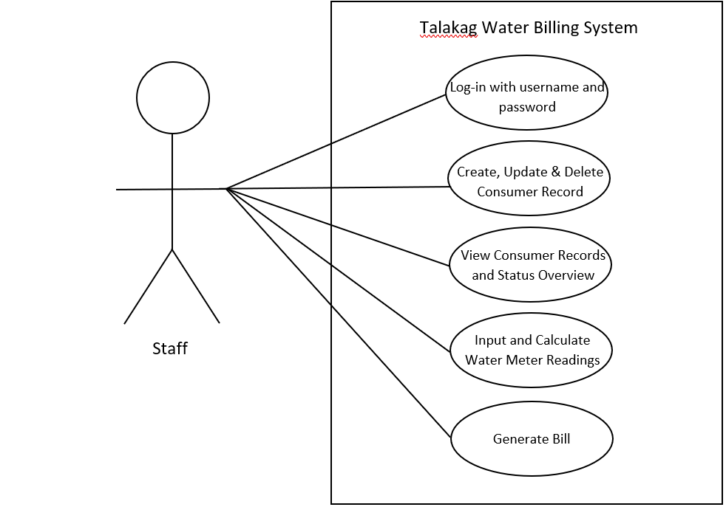

Slide 14
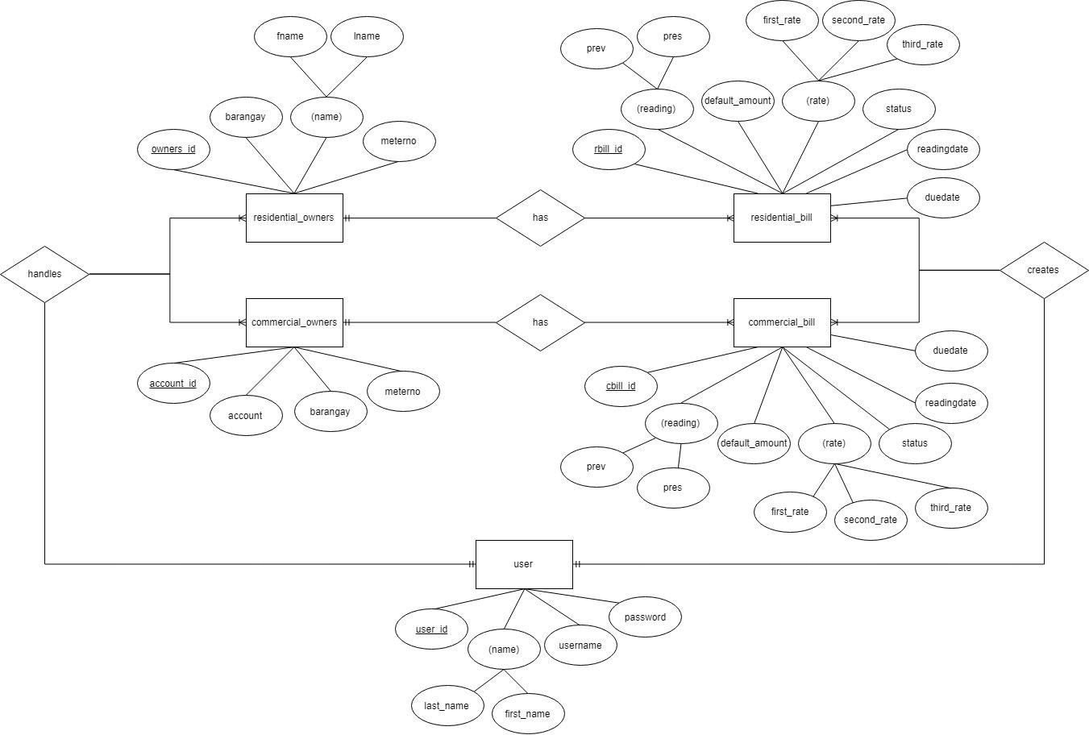

Slide 15
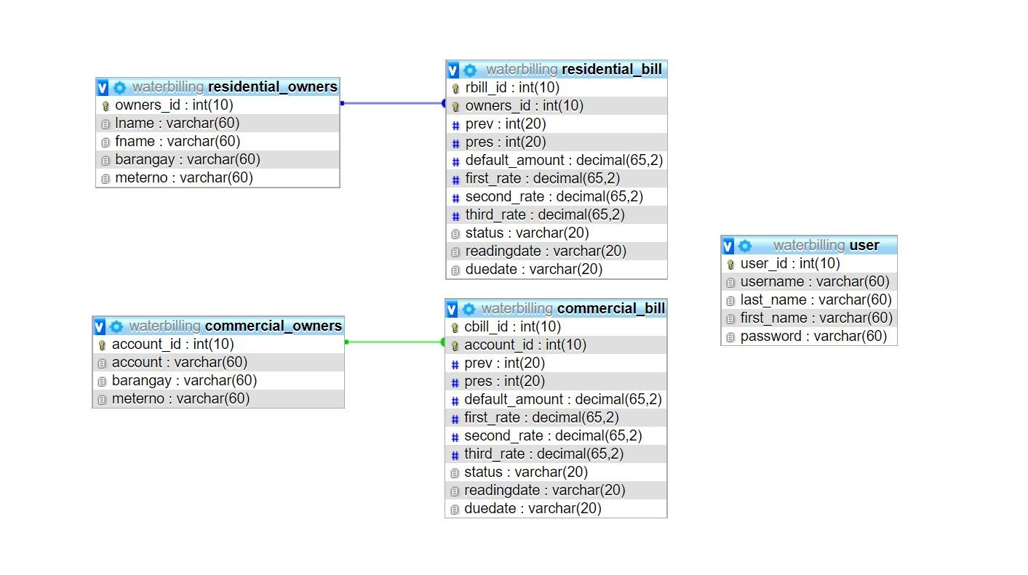

Slide 16
System Development
During the creation of the TMWS Water Billing System, particular tools were used in order to meet the desired outcome of the project scope.
For the overall foundation of the system, we used XAMPP as a tool that offers a server locally and it has a built-in back end administration tool called phpMyAdmin for managing the database with MySQL.

Slide 17
System Development
We then use PHP as our scripting language to store and retrieve the data from the database. For the front end of the system, we used HTML to prepare an overall layout.
When it comes to the design and look of the system, we used some default Bootstrap CSS but altered some along the way to meet the desired look. JavaScript was also used to perform certain functionality to the system like sorting the table, prompting messages, modals, pagination and others.

Slide 18
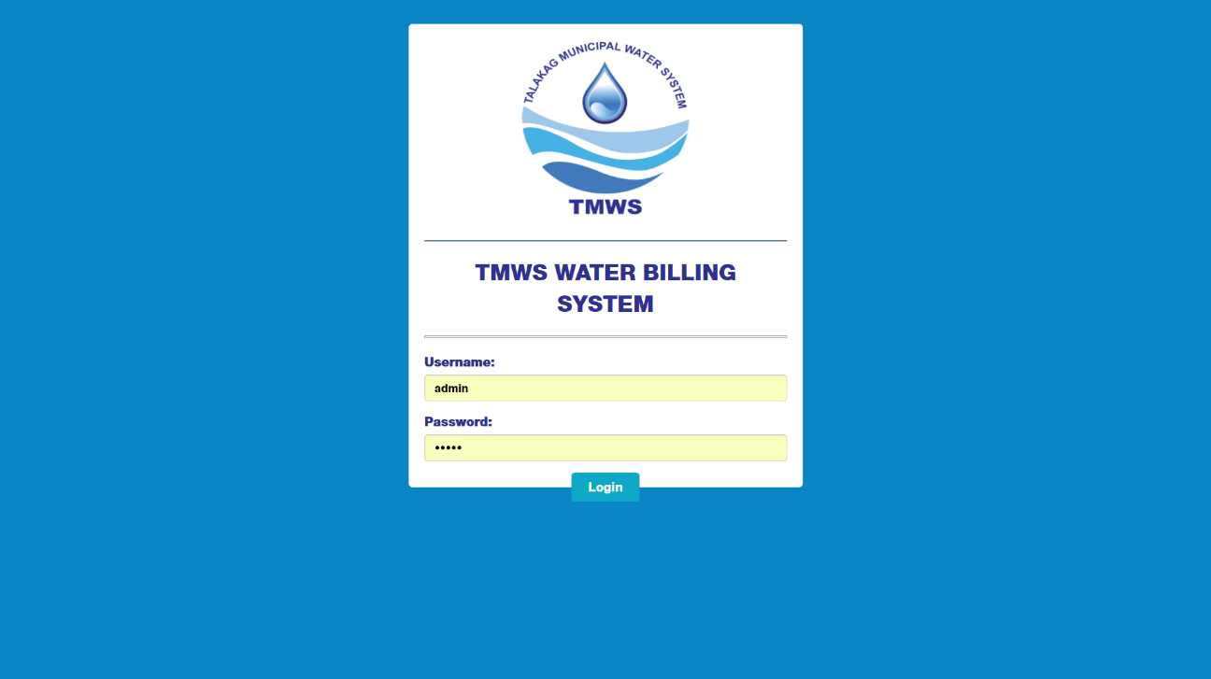
Login Page

Slide 19
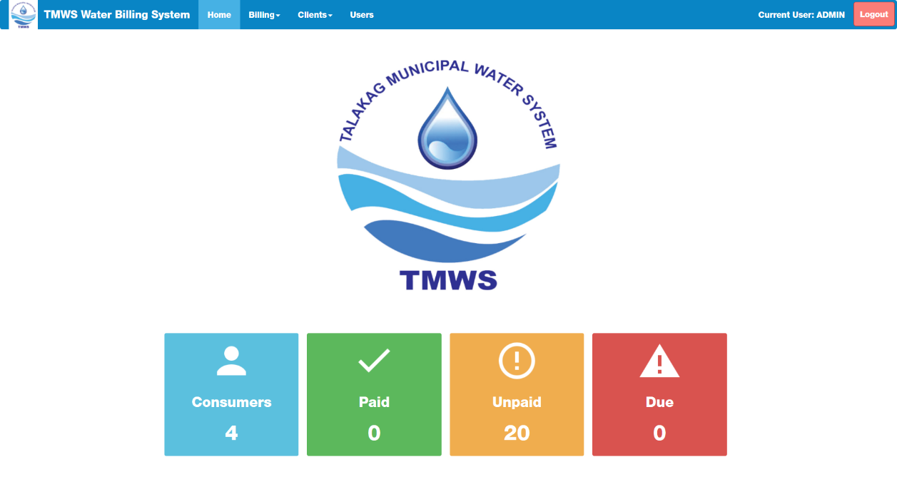
Homepage

Slide 20
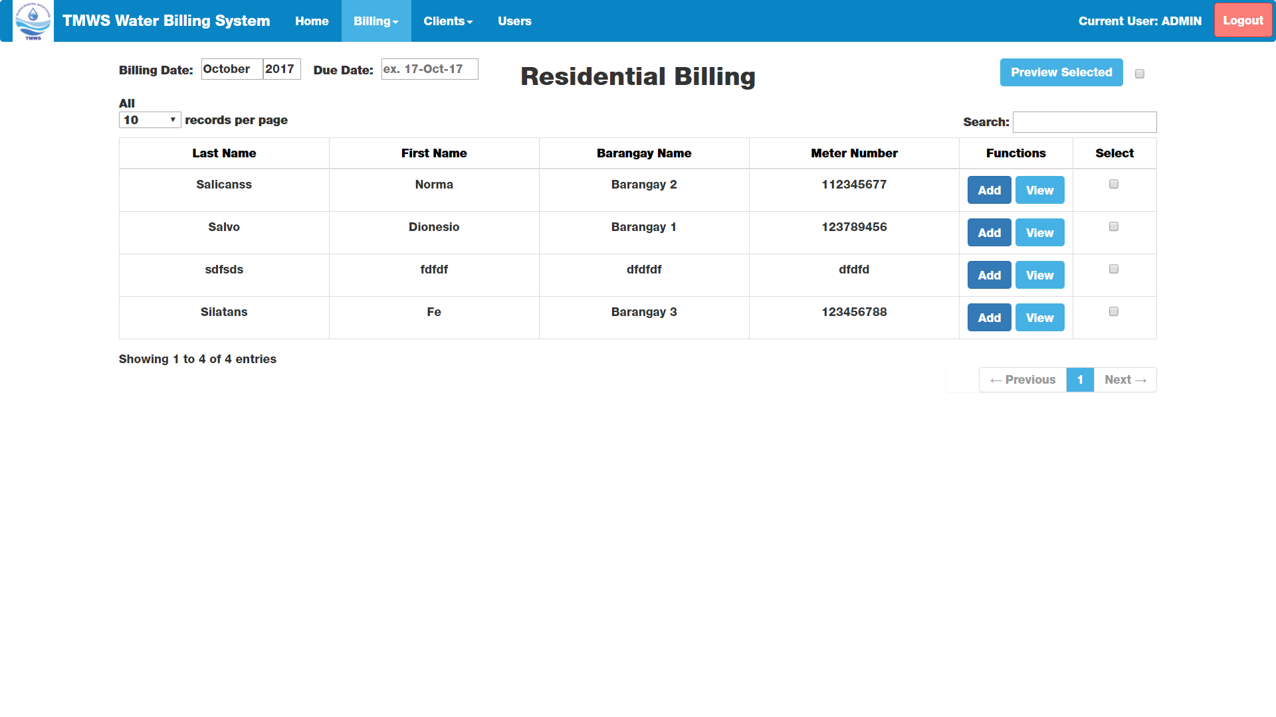
Residential Billing Page

Slide 21
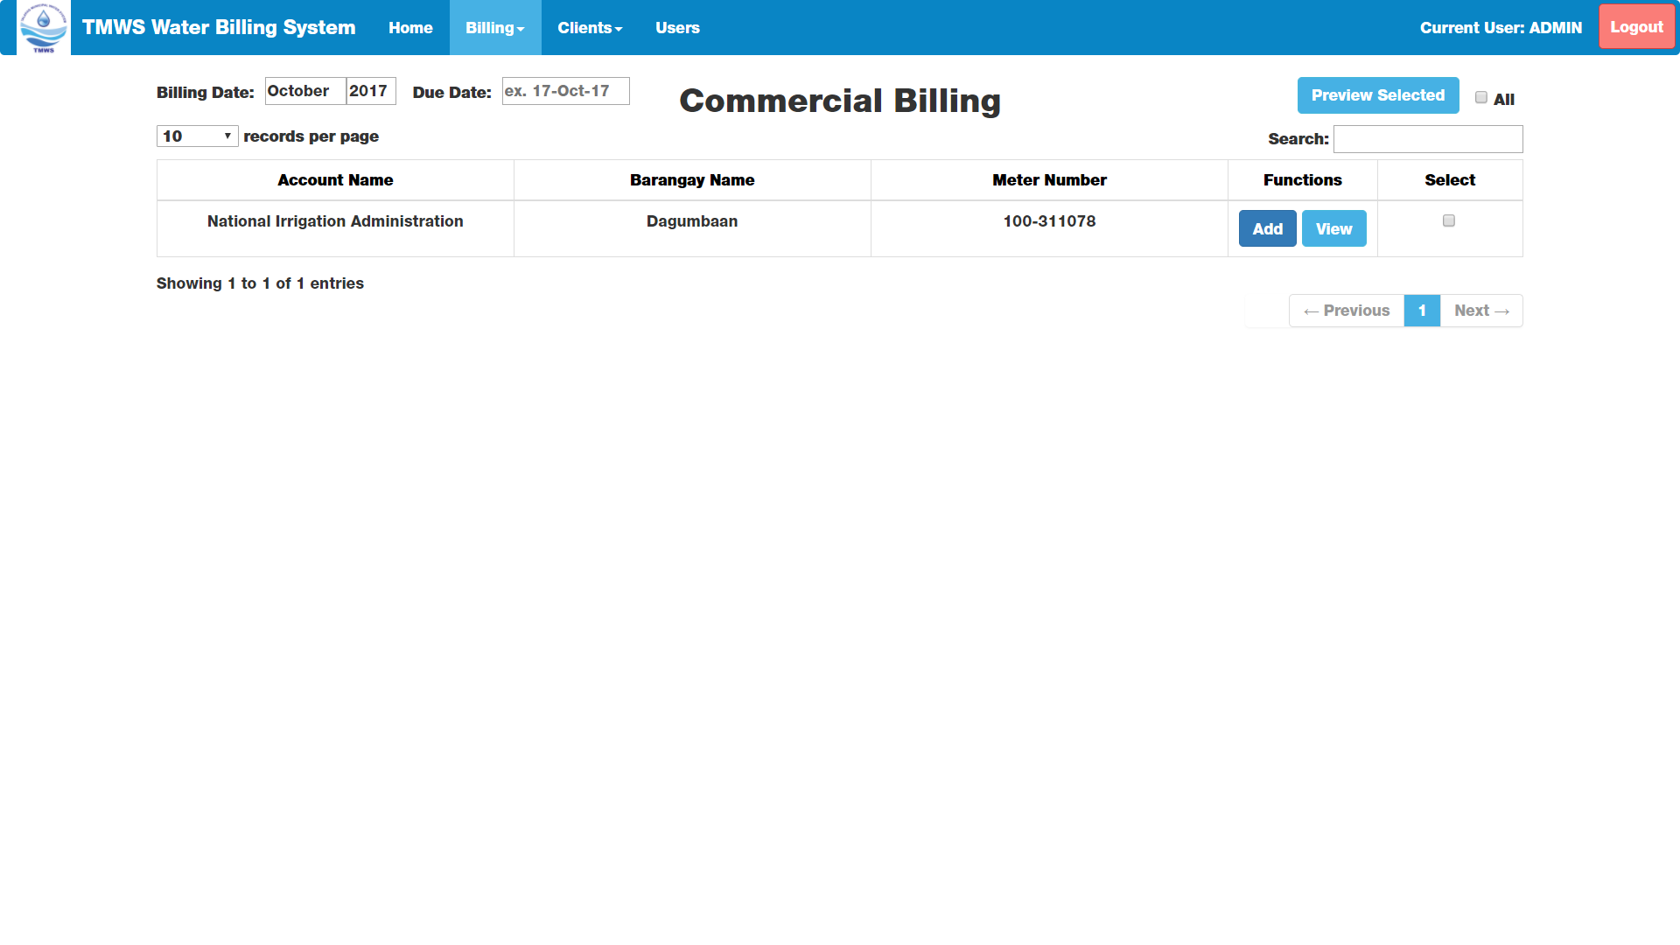
Commercial Billing Page

Slide 22
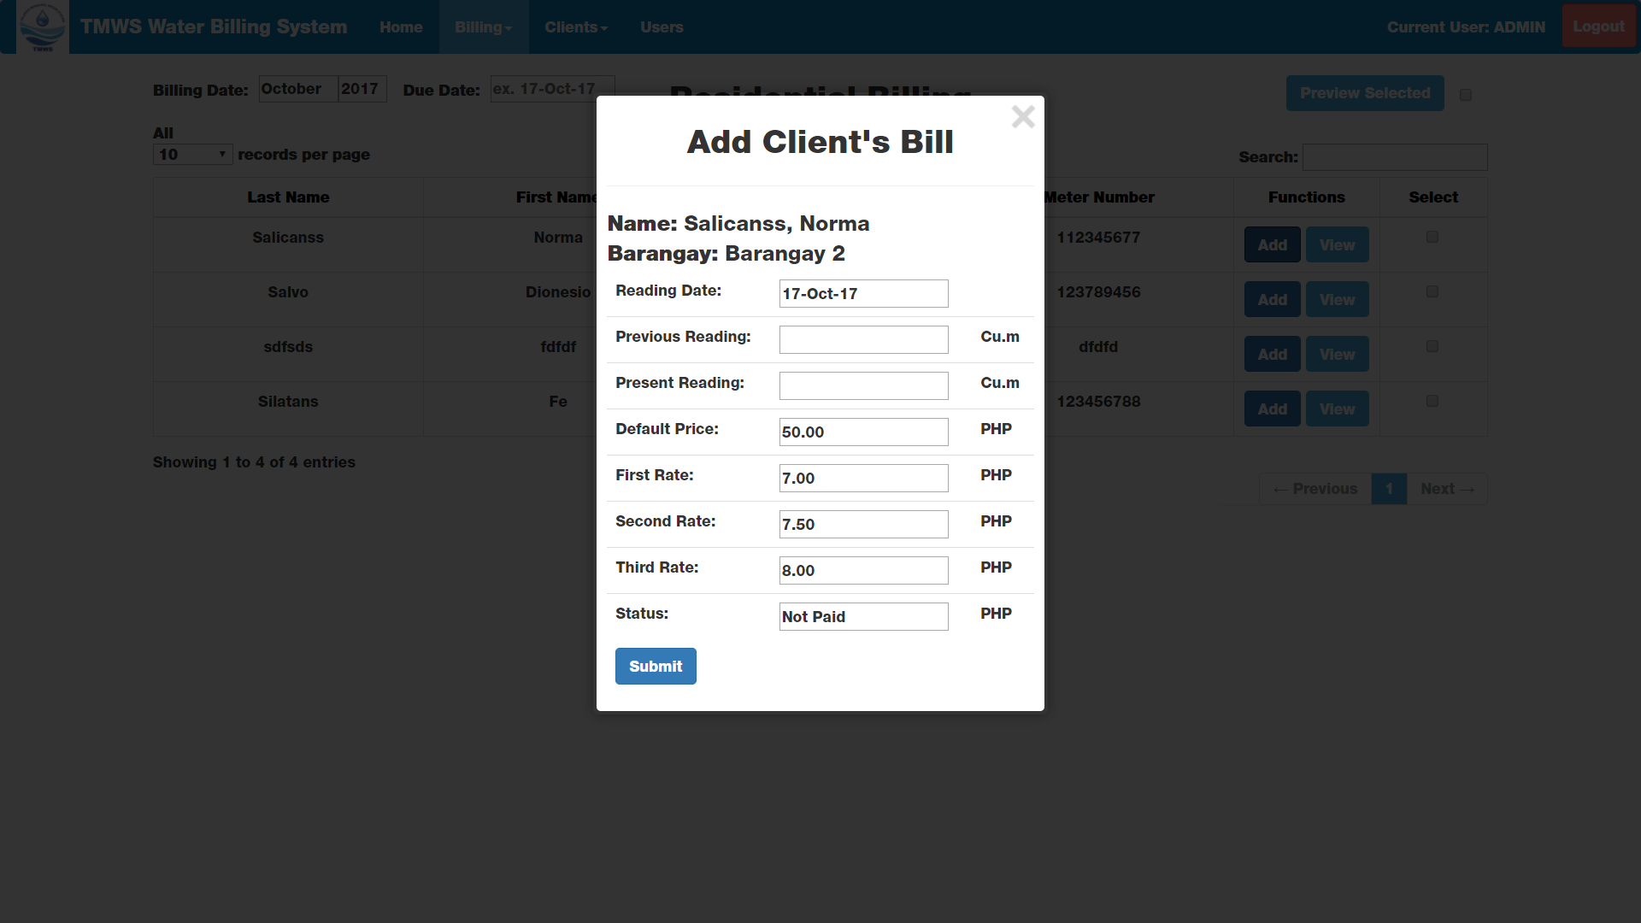
Add Bill Window

Slide 23
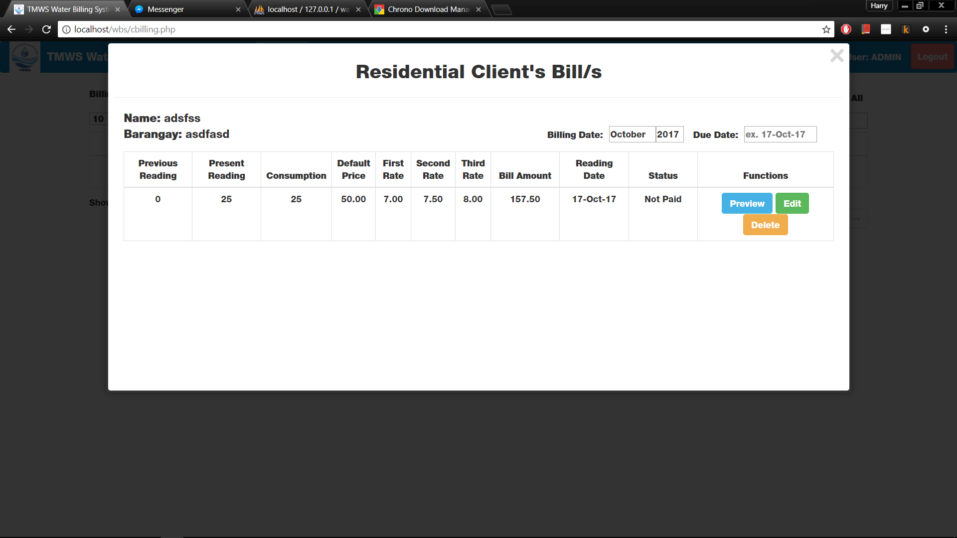
View Bill Window

Slide 24
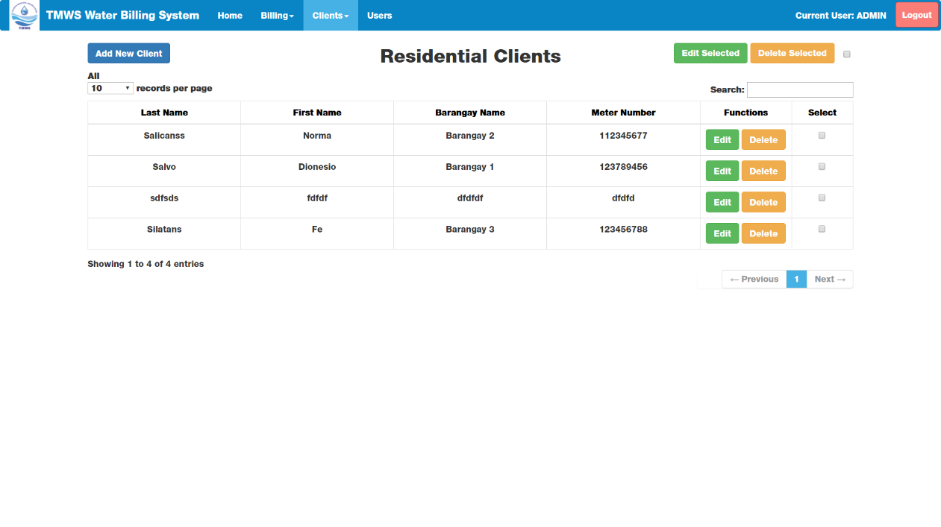
Client Profiles Page

Slide 25
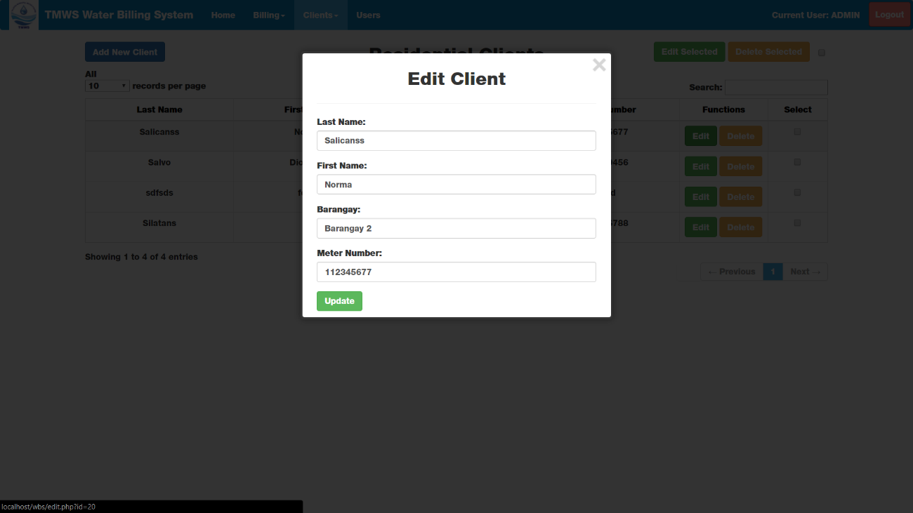
Edit Client Window

Slide 26
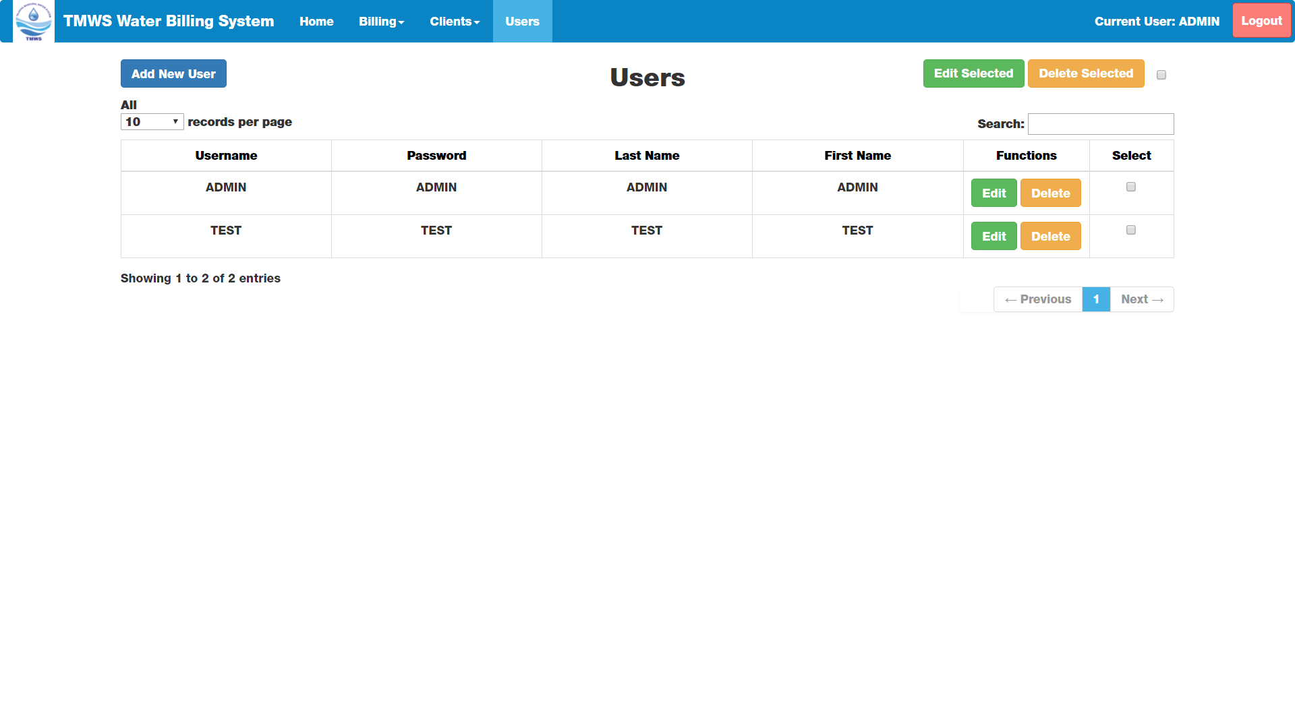
Users Page

Slide 27
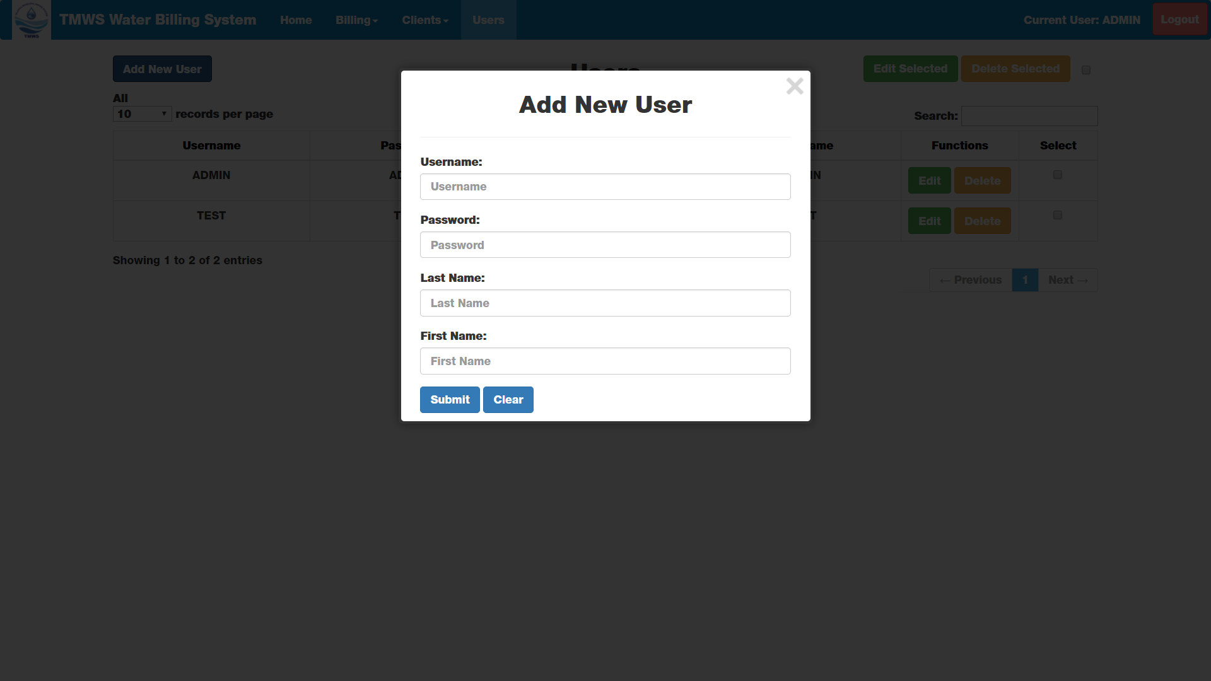
Add User Window

Slide 28
System Deployment
The TMWS (Talakag Municipal Water System) Water Billing System will have two instances in deployment, one (1) If we, the development team will gather and travel to Talakag to supervise the installation of the system or Two (2) If the staff in charge will be assigned to install the system.

Slide 29
System Deployment
First Instance; Seven members of our team will travel from Cagayan De Oro to Talakag, Bukidnon and bring the required files for the installation: XAMPP Installer and TMWBS Files which includes the documentation. Three members of our team will transfer the files to the system host and follow the procedure to install accordingly accompanied by the remaining members to further explain for clarification.

Slide 30
System Deployment
Second Instance; A staff from Talakag Municipal will be shown a demonstration from the installation to interaction of the system and clarify specific areas that needed further explanation requested by the staff.

